Slide 1
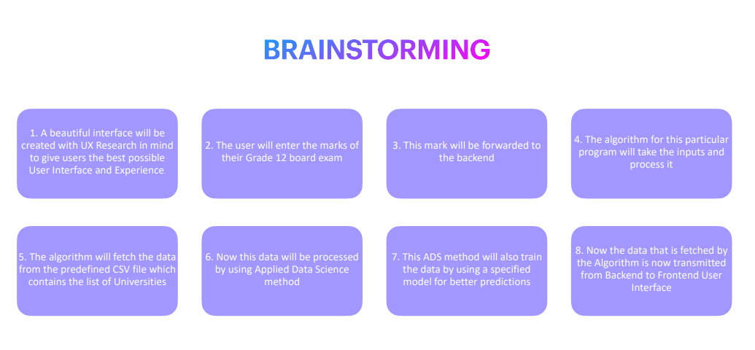

Slide 2
IBM-Project-32052-1660207765

